Slide 1
Agile Methodolgies
Raphael Salaja
A00269349
Caylum McMahon
A00269988
Conor O’Dowd
A00272464
Christopher Presinal
A00271482

Slide 2
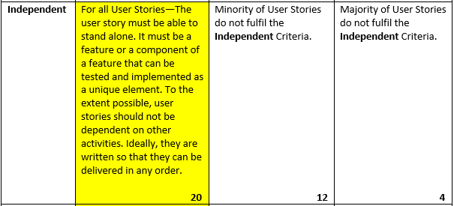
Independent

Slide 3
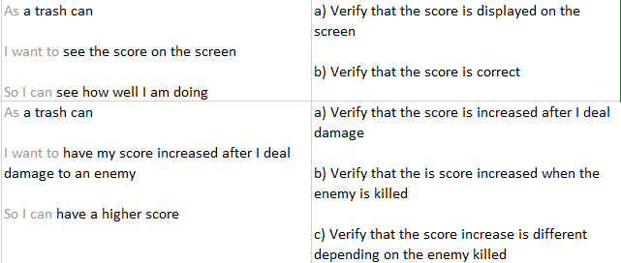
Scoring

Slide 4
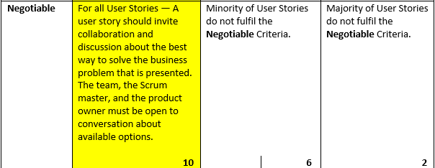
Negotiable

Slide 5
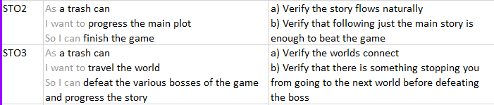
Story

Slide 6
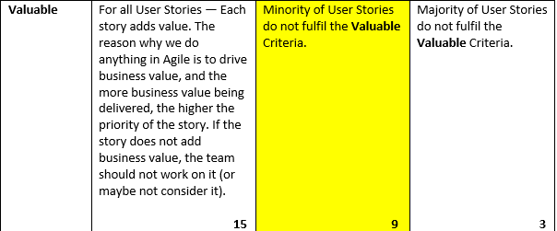
Valuable

Slide 7
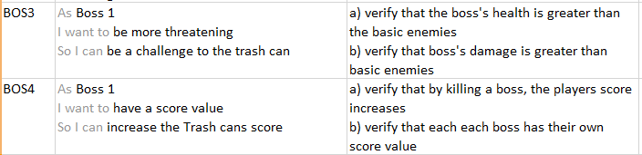
Boss

Slide 8
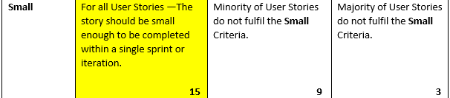
Small

Slide 9
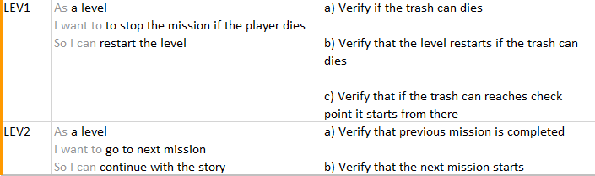
Levels

Slide 10
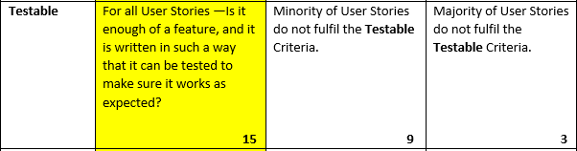
Testable

Slide 11
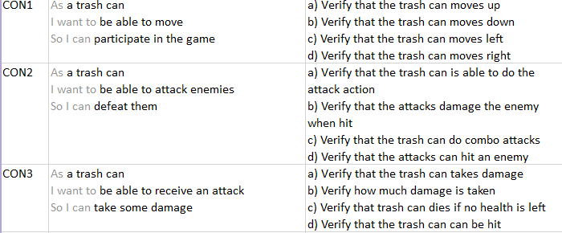
The Player

Slide 12
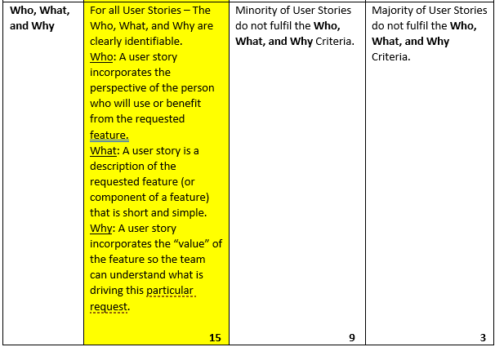
Who, What, Why

Slide 13
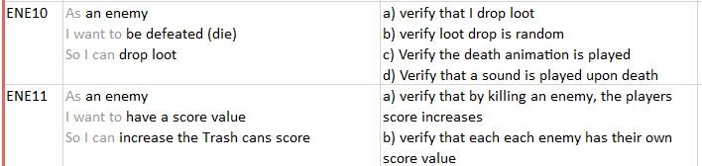
Enemies

